Slide 1
Foundations of Machine Learning
Module 7: Computational Learning Theory
Part A
Sudeshna Sarkar
IIT Kharagpur

Slide 2
Sample Complexity: Infinite Hypothesis Spaces
Need some measure of the expressiveness of infinite hypothesis spaces.
The Vapnik-Chervonenkis (VC) dimension provides such a measure, denoted VC(H).
Analagous to ln|H|, there are bounds for sample complexity using VC(H).

Slide 3
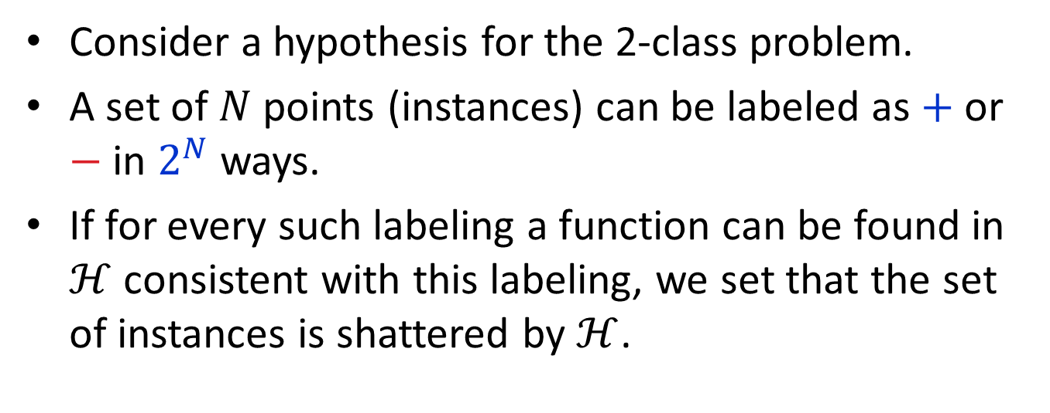
Shattering
Consider a hypothesis for the 2-class problem.
A set of $N$ points (instances) can be labeled as $+$ or $−$ in $2^{N}$ ways.
If for every such labeling a function can be found in $ℋ$ consistent with this labeling, we set that the set of instances is shattered by $ℋ$.

Slide 4
Three points in R²
It is enough to find one set of three points that can be shattered.
It is not necessary to be able to shatter every possible set of three points in 2 dimensions

Slide 6
Shattering Instances
Consider 2 instances described using a single real-valued feature being shattered by a single interval.
x y

Slide 7
Shattering Instances (cont)
But 3 instances cannot be shattered by a single interval.
x y z
x
y
z
+ – _ x,y,z
x y,z
y x,z
x,y z
x,y,z
y,z x
z x,y
x,z y
Cannot do

Slide 8
VC Dimension
The Vapnik-Chervonenkis dimension, VC(H). of hypothesis space H defined over instance space X is the size of the largest finite subset of X shattered by H. If arbitrarily large finite subsets of X can be shattered then VC(H) = ∞
If there exists at least one subset of X of size d that can be shattered then VC(H) ≥ d.
If no subset of size d can be shattered, then VC(H) < d.
For a single intervals on the real line, all sets of 2 instances can be shattered, but no set of 3 instances can, so VC(H) = 2.

Slide 9
VC Dimension
An unbiased hypothesis space shatters the entire instance space.
The larger the subset of X that can be shattered, the more expressive (and less biased) the hypothesis space is.
The VC dimension of the set of oriented lines in 2-d is three.
Since there are 2^{m} partitions of m instances, in order for H to shatter instances: |H| ≥ 2^{m}.
Since |H| ≥ 2^{m}, to shatter m instances, VC(H) ≤ log₂|H|

Slide 10
VC Dimension Example
Consider axis-parallel rectangles in the real-plane, i.e. conjunctions of intervals on two real-valued features. Some 4 instances can be shattered.
Some 4 instances cannot be shattered:

Slide 11
VC Dimension Example (cont)
No five instances can be shattered since there can be at most 4 distinct extreme points (min and max on each of the 2 dimensions) and these 4 cannot be included without including any possible 5th point.
Therefore VC(H) = 4
Generalizes to axis-parallel hyper-rectangles (conjunctions of intervals in n dimensions): VC(H)=2n.

Slide 12
Upper Bound on Sample Complexity with VC
Using VC dimension as a measure of expressiveness, the following number of examples have been shown to be sufficient for PAC Learning (Blumer et al., 1989).
Compared to the previous result using ln|H|, this bound has some extra constants and an extra log₂(1/ε) factor. Since VC(H) ≤ log₂|H|, this can provide a tighter upper bound on the number of examples needed for PAC learning.

Slide 13
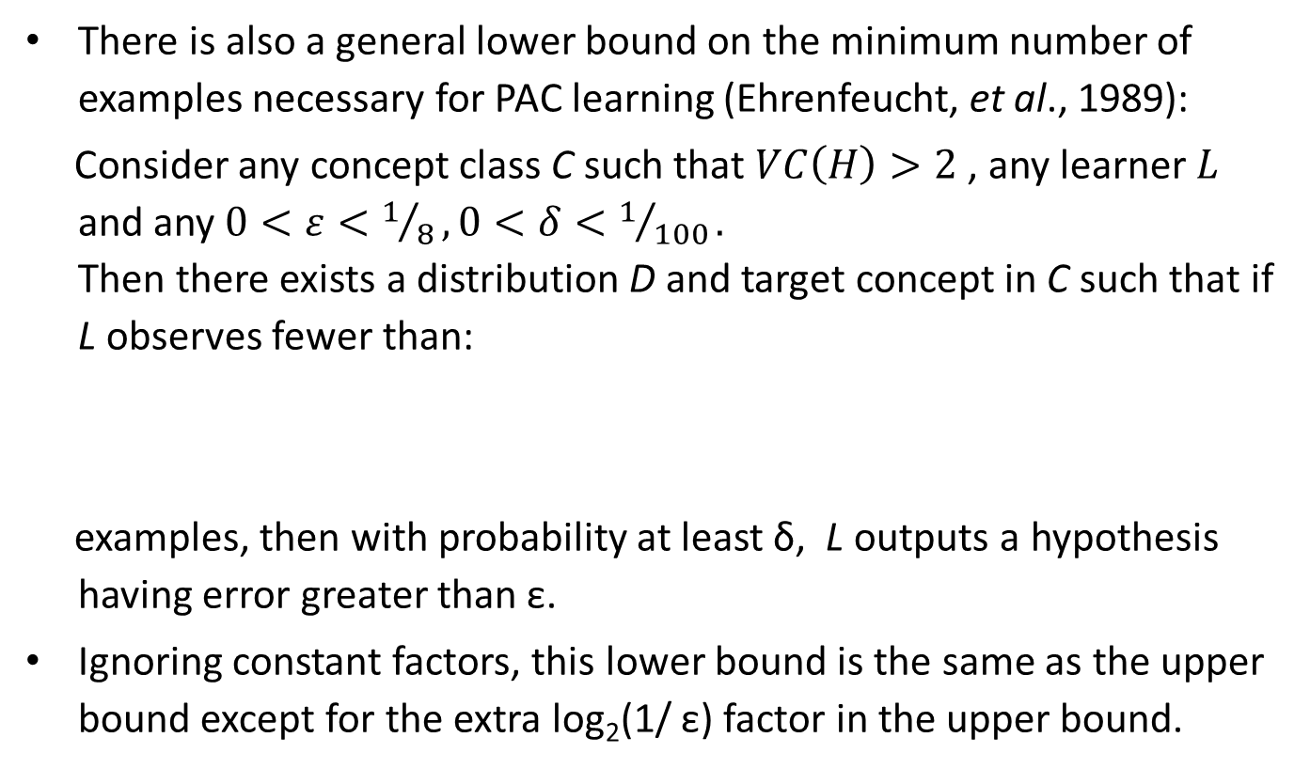
Sample Complexity Lower Bound with VC
There is also a general lower bound on the minimum number of examples necessary for PAC learning (Ehrenfeucht, et al., 1989):
Consider any concept class C such that $VC\left(H\right)>2$ , any learner $L$ and any $0<ε<1/8, 0<δ<1/{100}.$ Then there exists a distribution D and target concept in C such that if L observes fewer than:
examples, then with probability at least δ, L outputs a hypothesis having error greater than ε.
Ignoring constant factors, this lower bound is the same as the upper bound except for the extra log₂(1/ ε) factor in the upper bound.

Slide 14
Thank You

